Slide 1
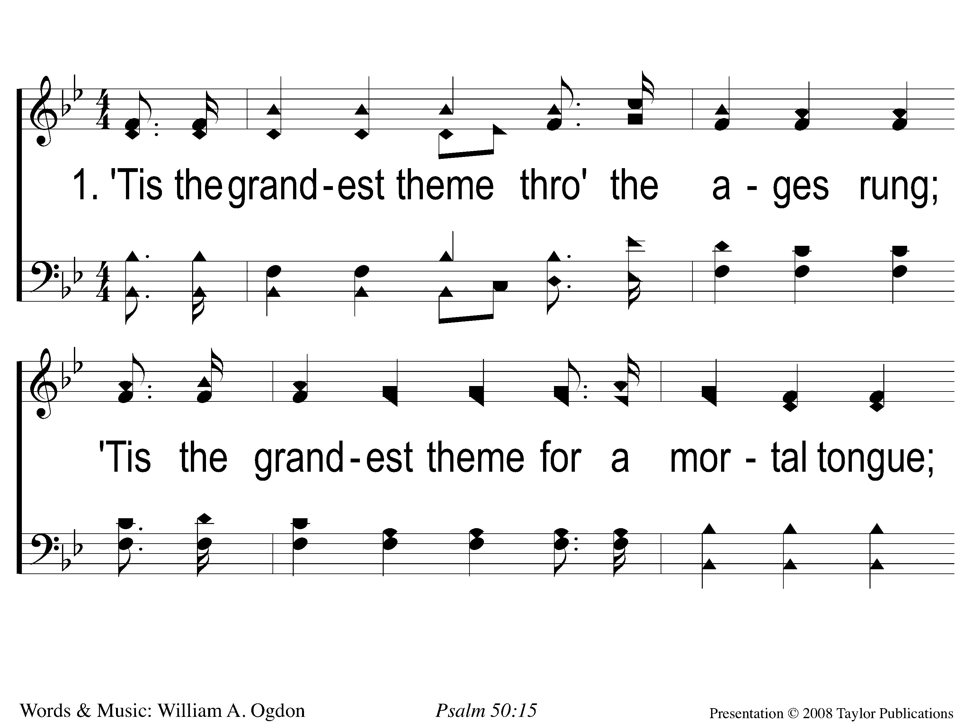
1-1 He Is Able To Deliver Thee
He Is Able To Deliver Thee
171

Slide 2
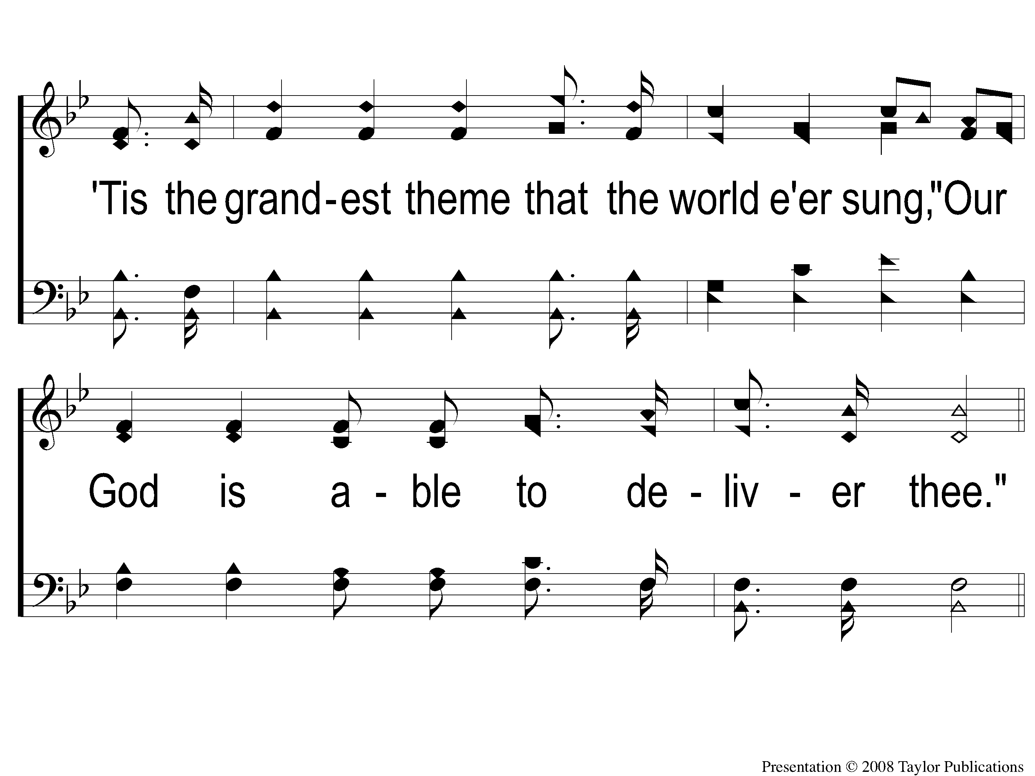
1-2 He Is Able To Deliver Thee
He Is Able To Deliver Thee
171

Slide 3
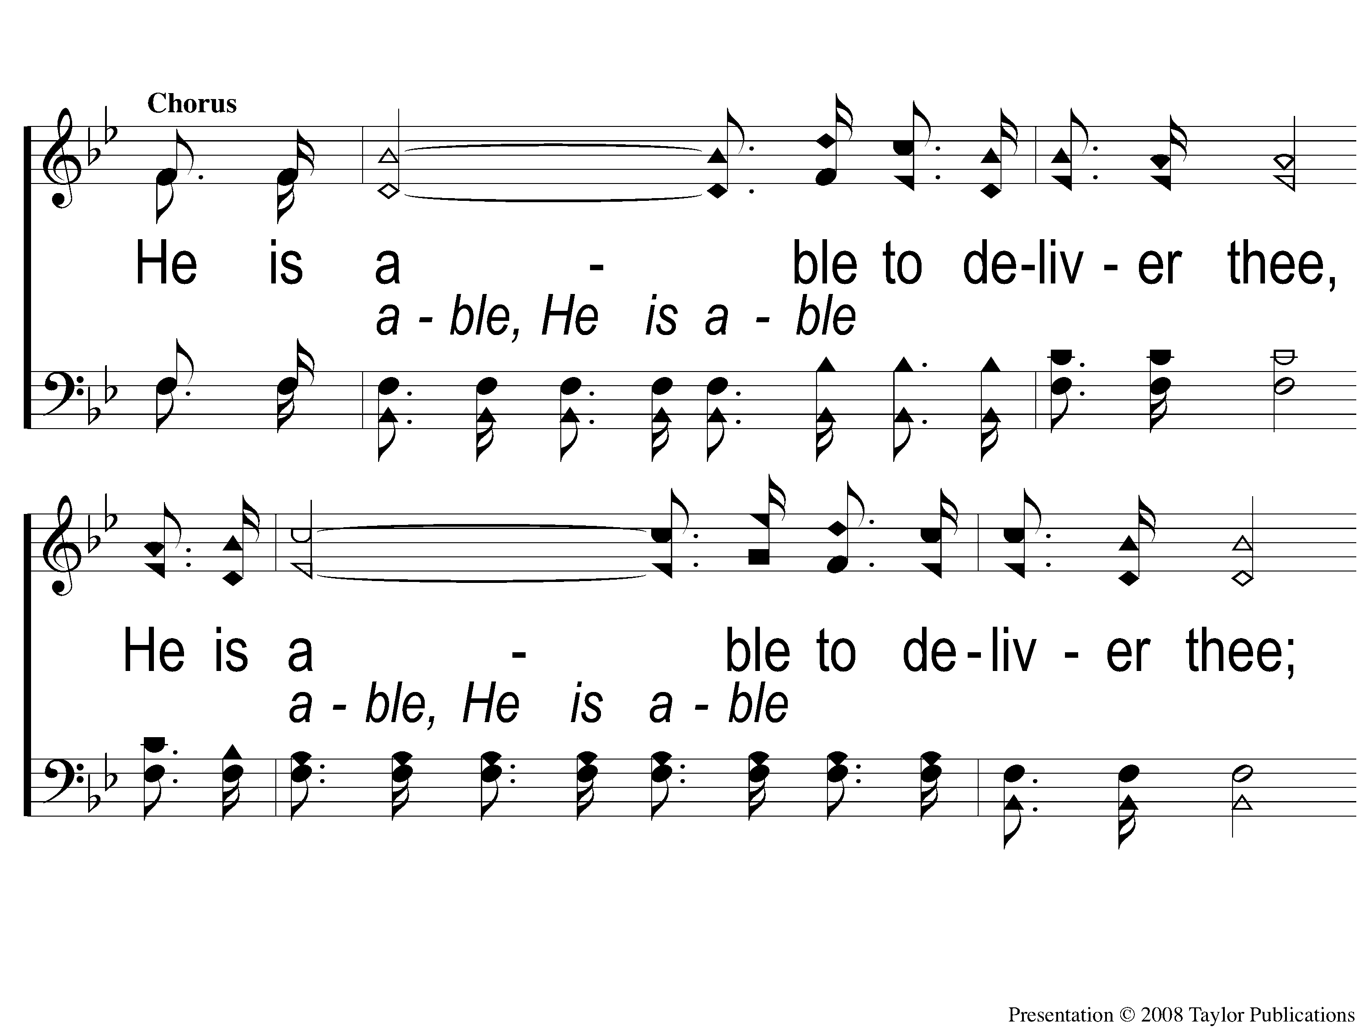
C-1 He Is Able To Deliver Thee
He Is Able To Deliver Thee
171

Slide 4
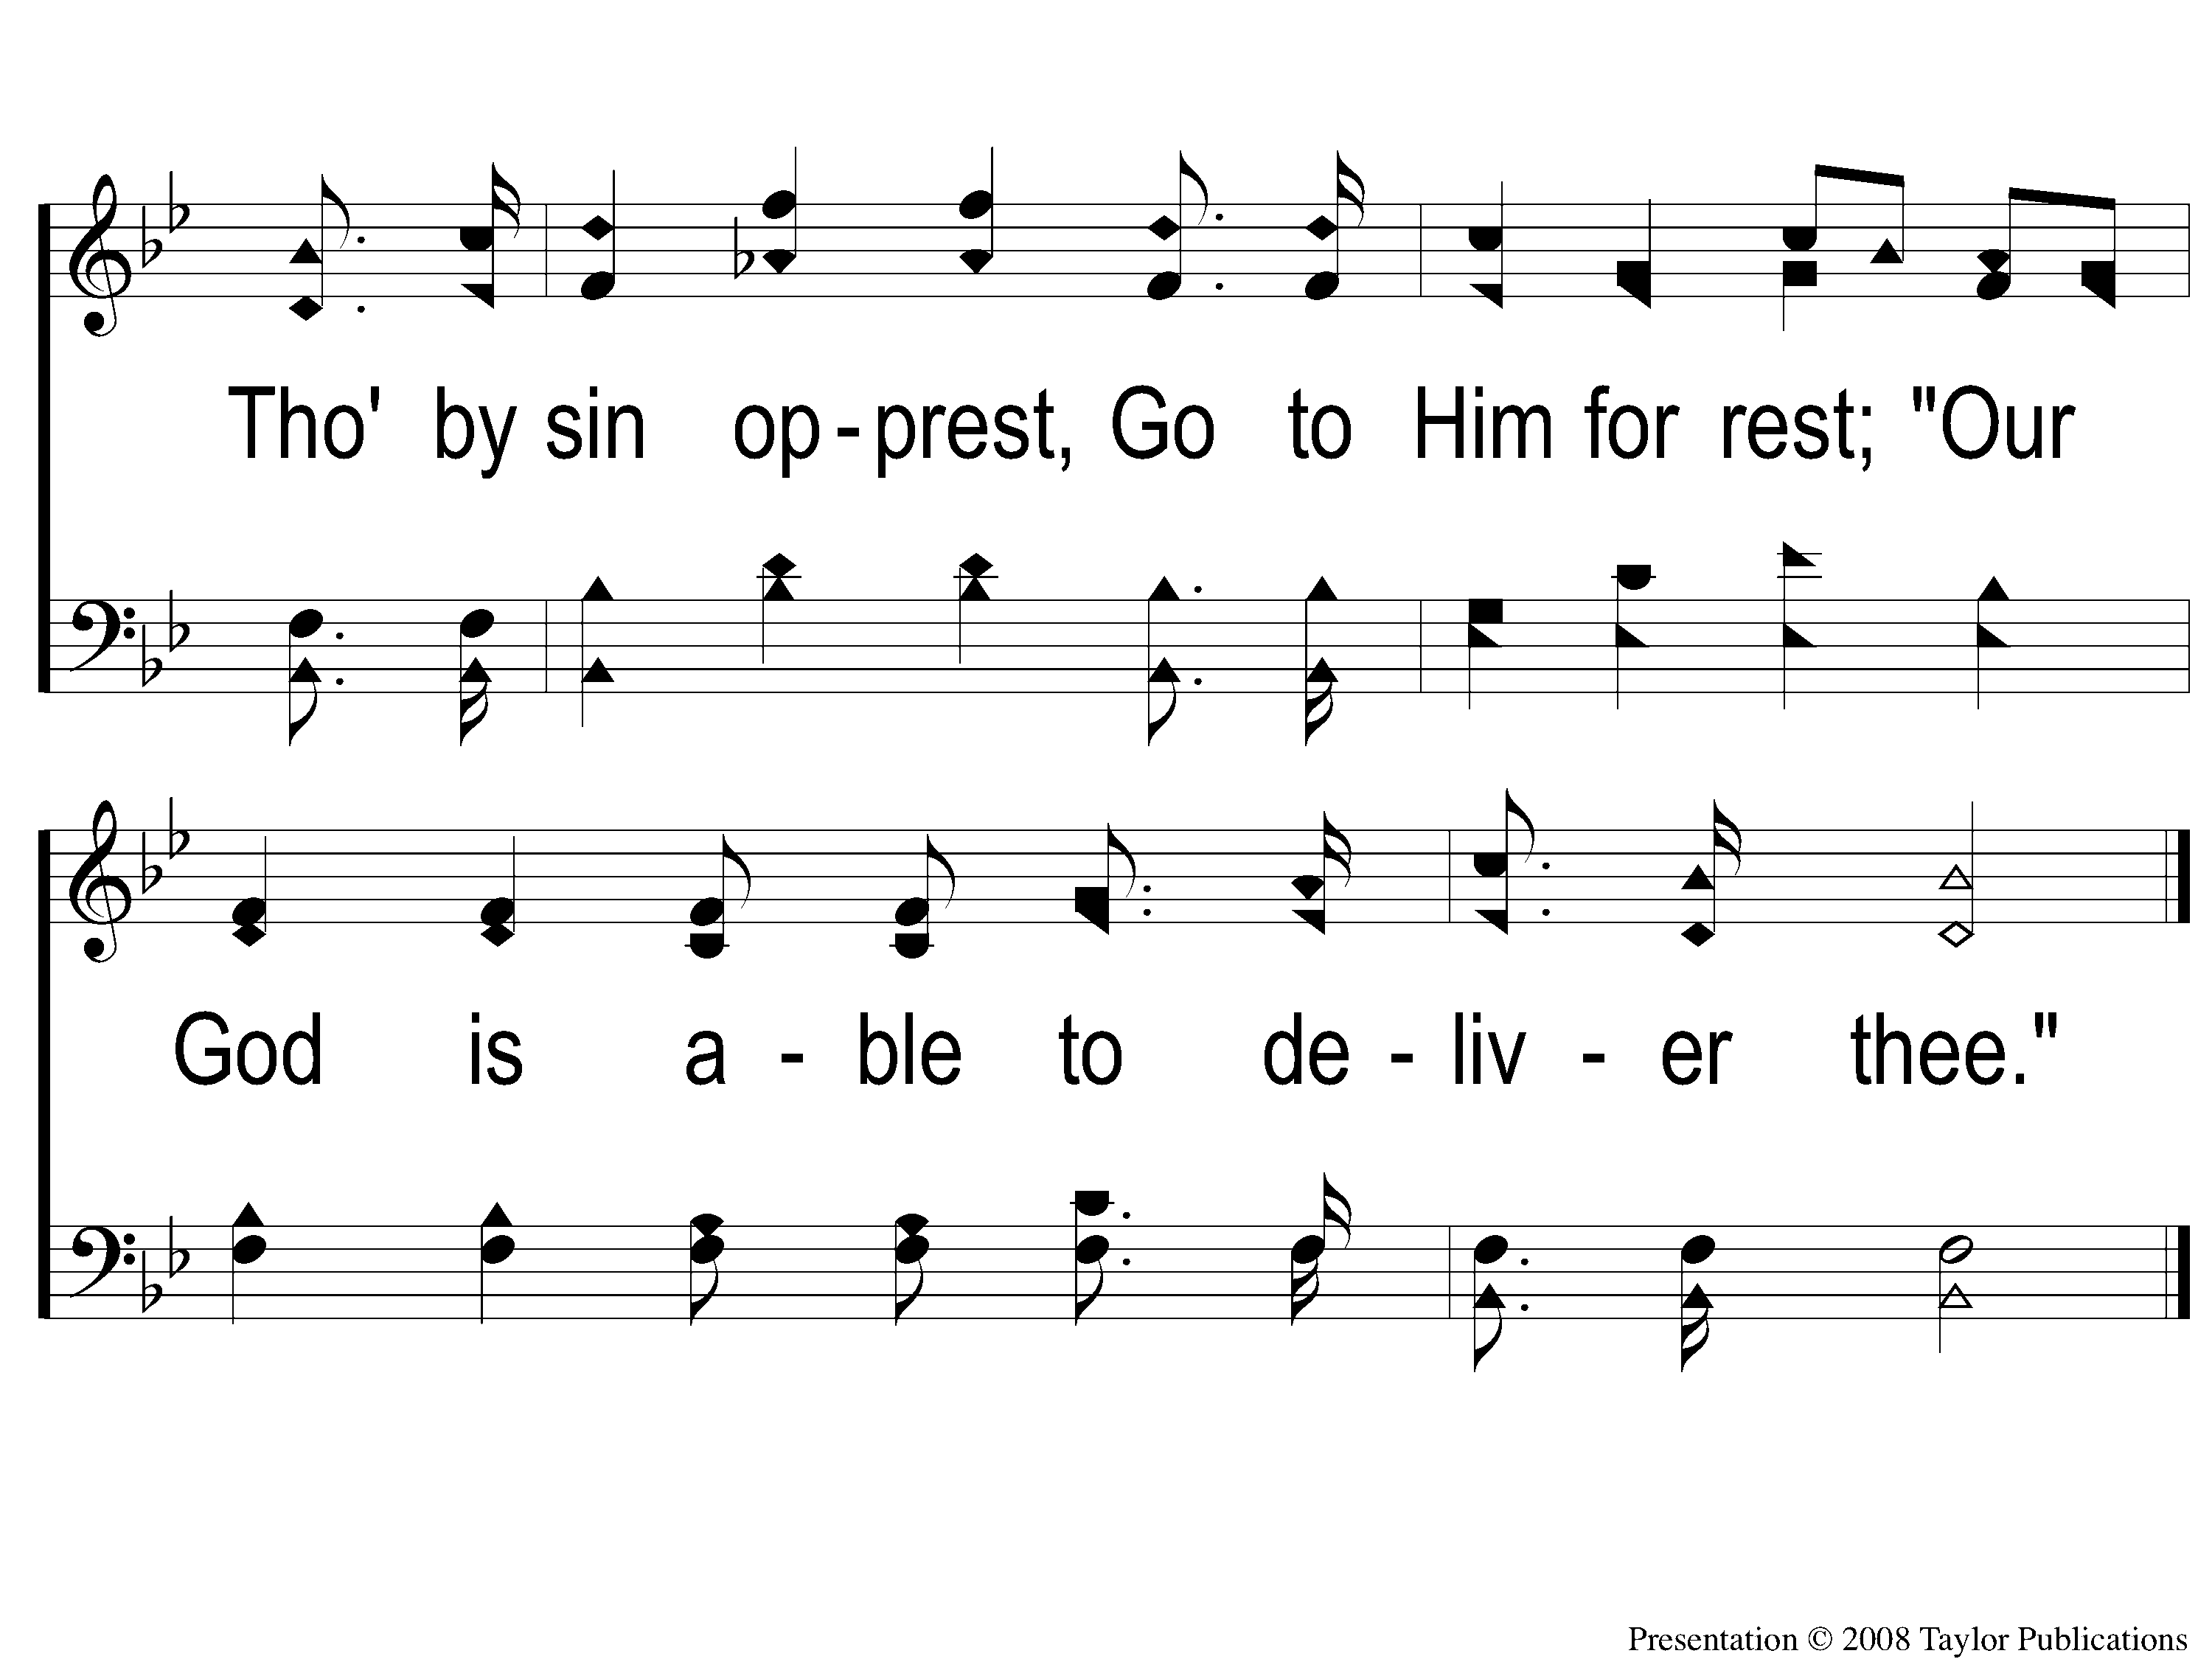
C-2 He Is Able To Deliver Thee
He Is Able To Deliver Thee
171

Slide 5
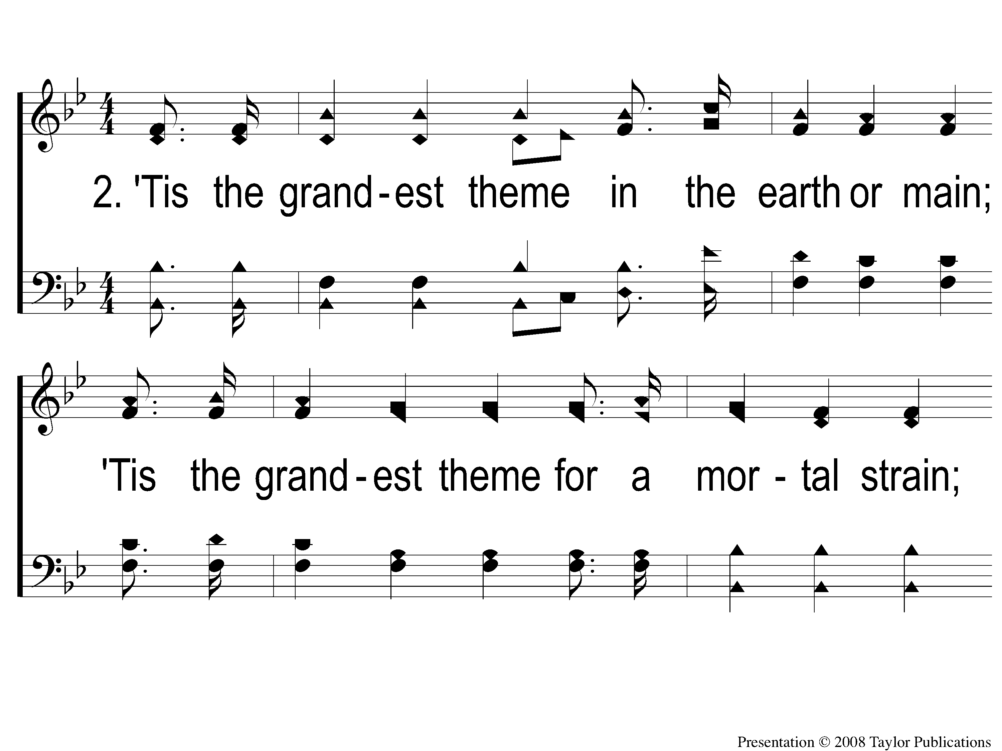
2-1 He Is Able To Deliver Thee
He Is Able To Deliver Thee
171

Slide 6
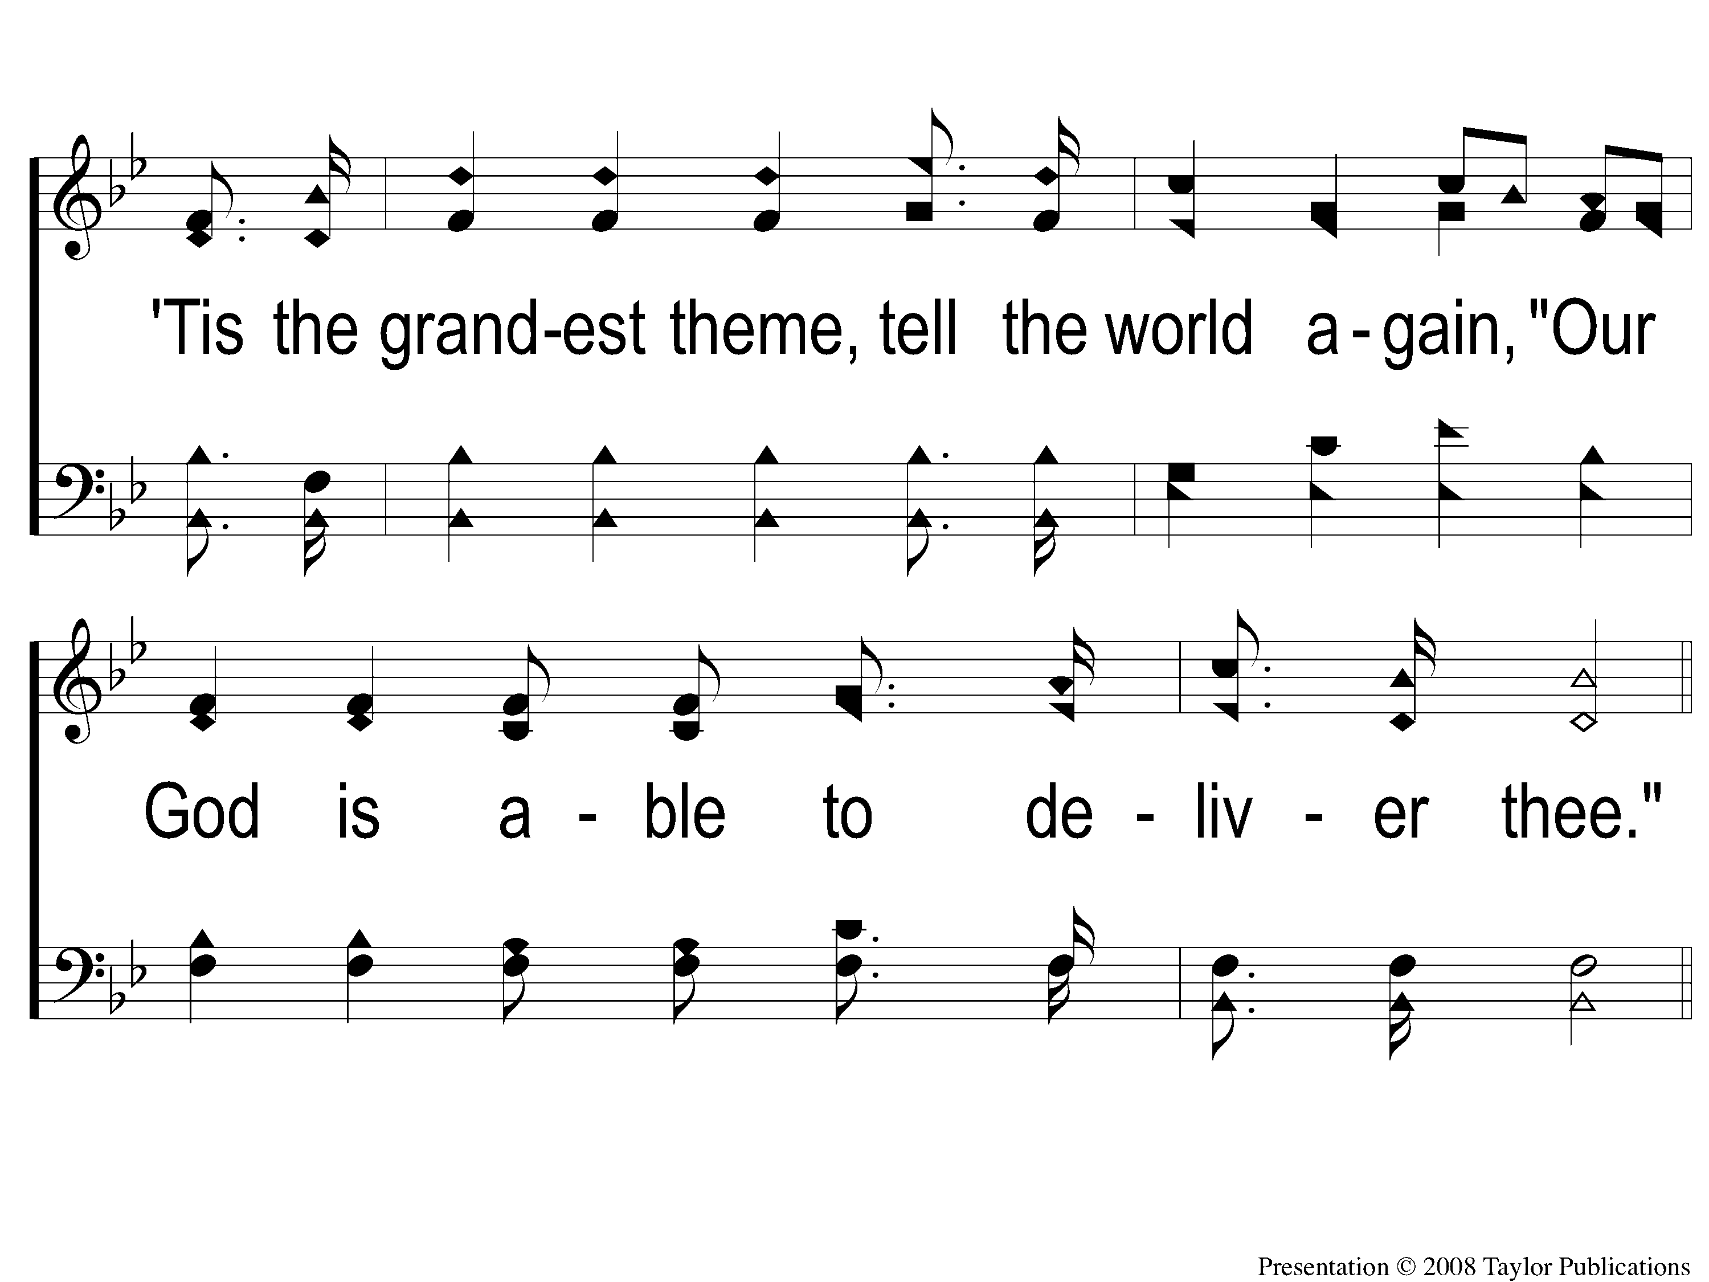
2-2 He Is Able To Deliver Thee
He Is Able To Deliver Thee
171

Slide 7
C-1 He Is Able To Deliver Thee
He Is Able To Deliver Thee
171

Slide 8
C-2 He Is Able To Deliver Thee
He Is Able To Deliver Thee
171

Slide 9
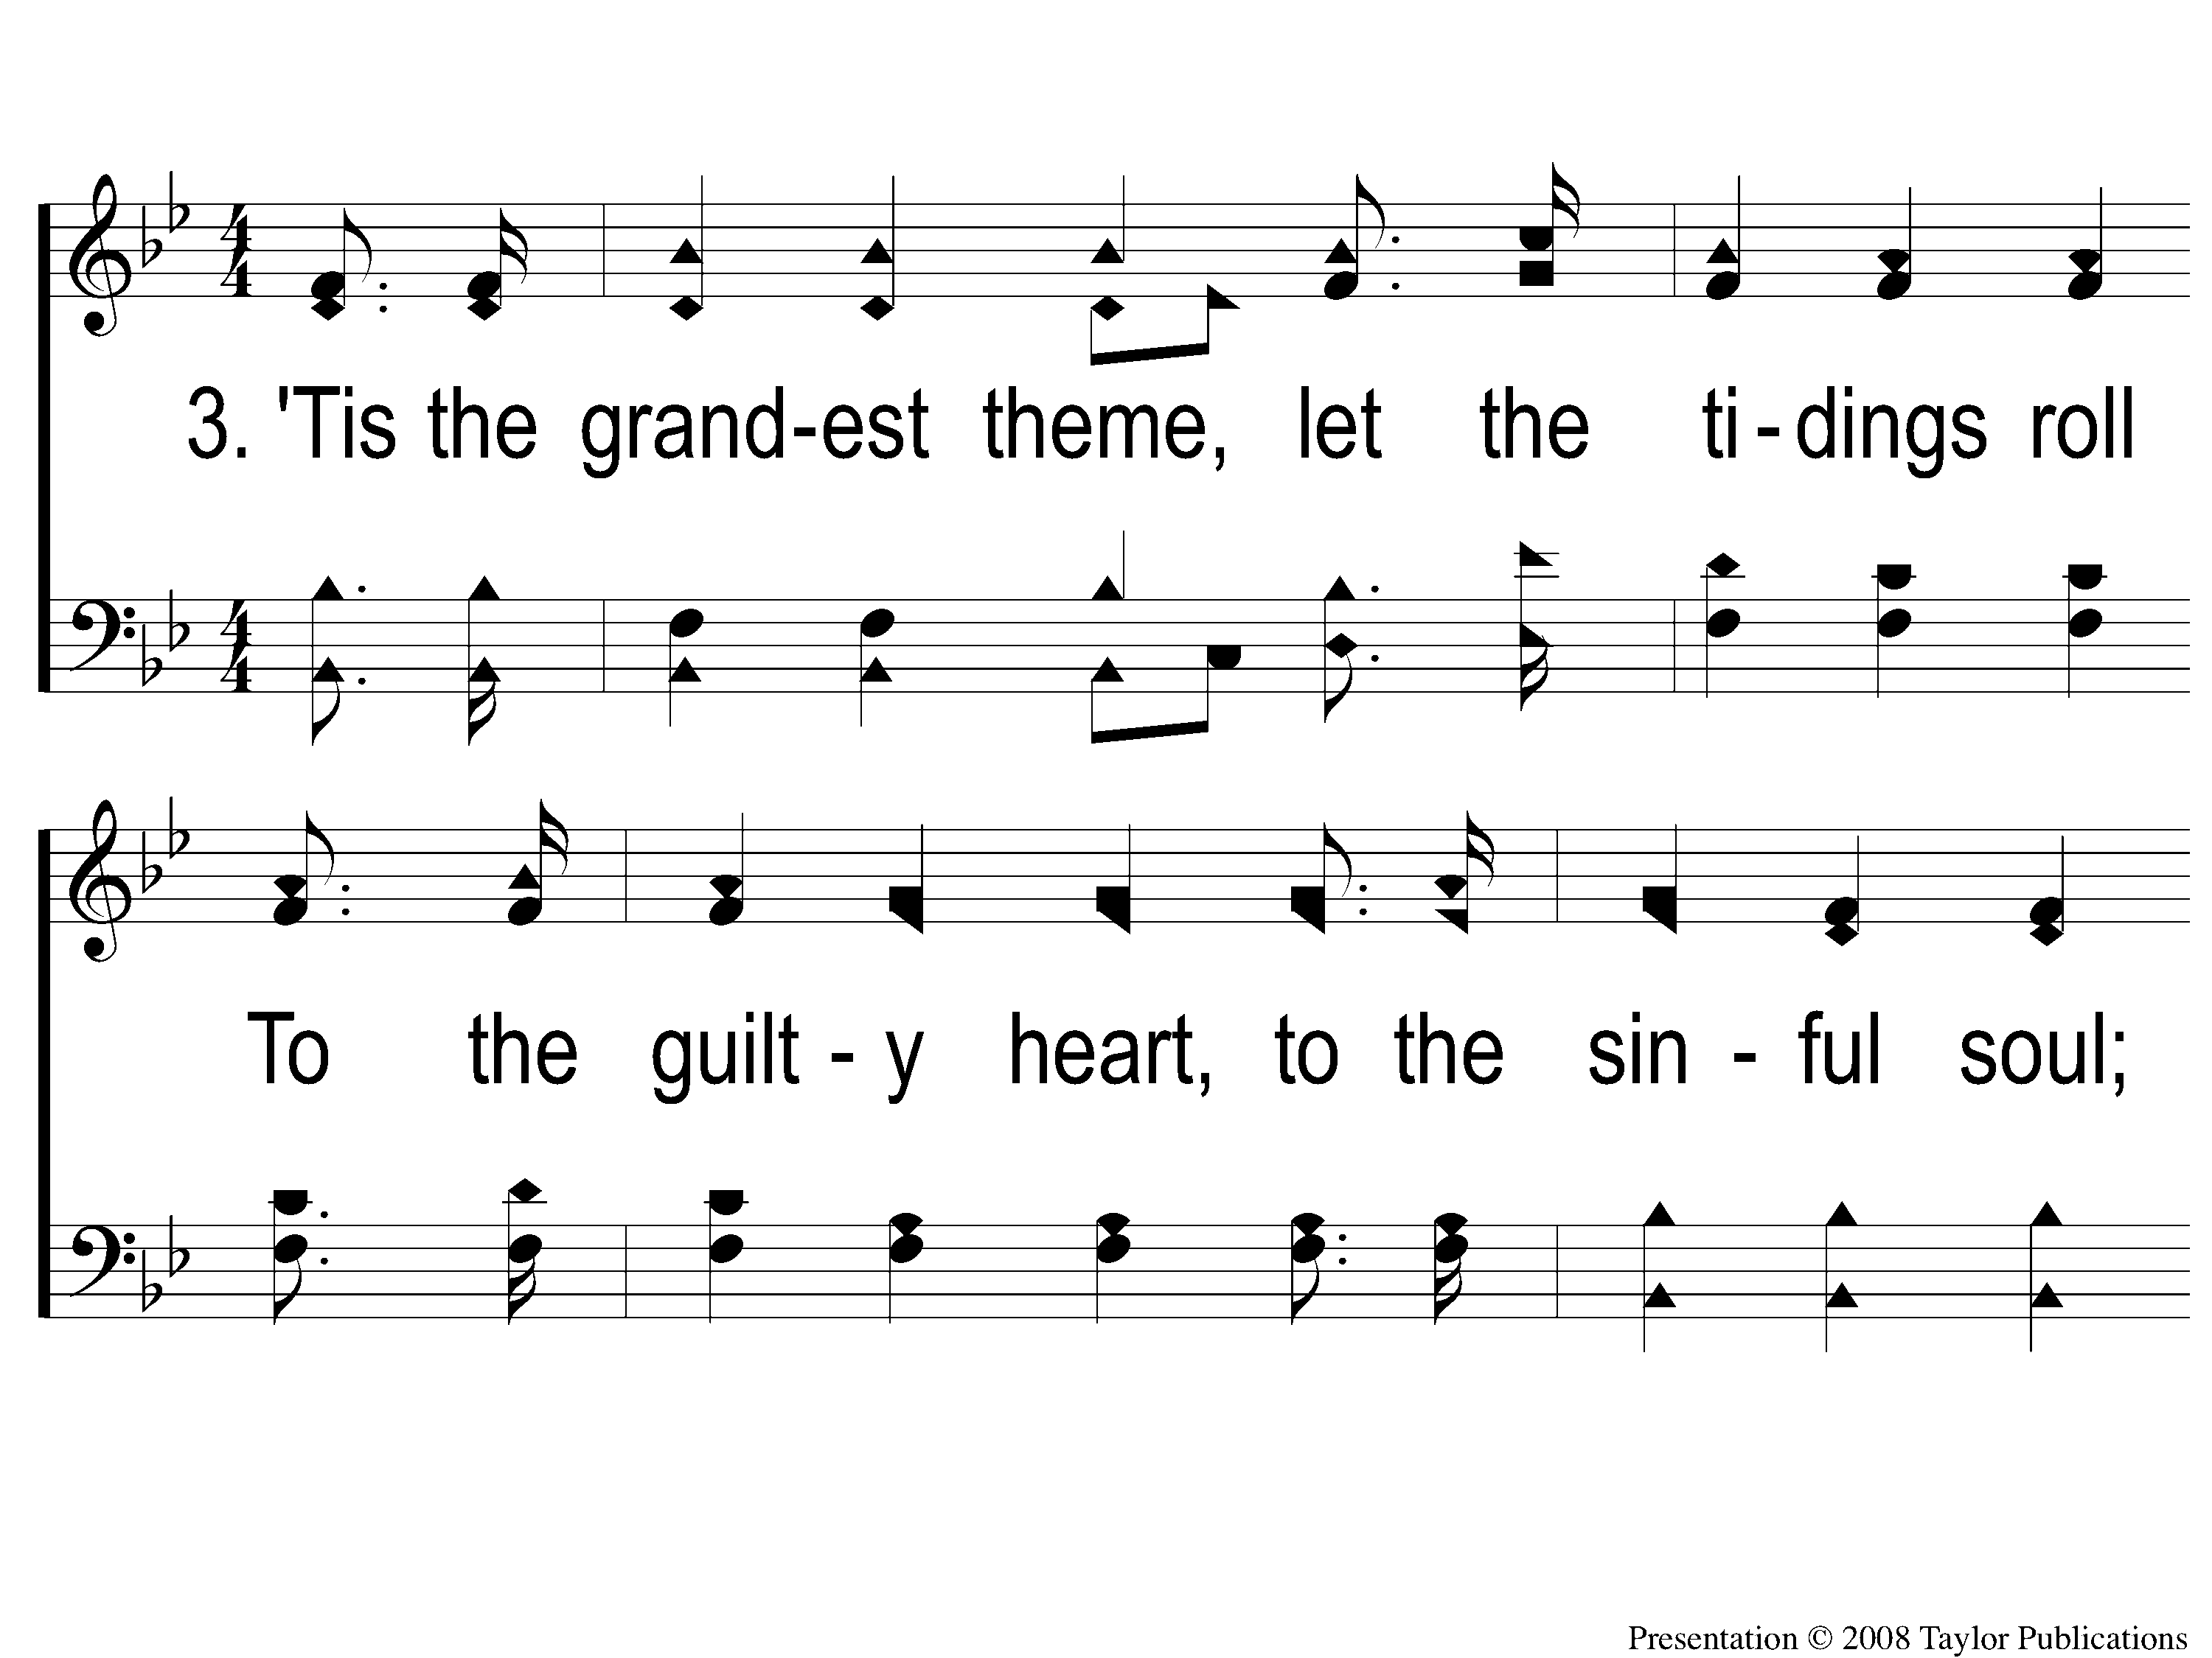
3-1 He Is Able To Deliver Thee
He Is Able To Deliver Thee
171

Slide 10
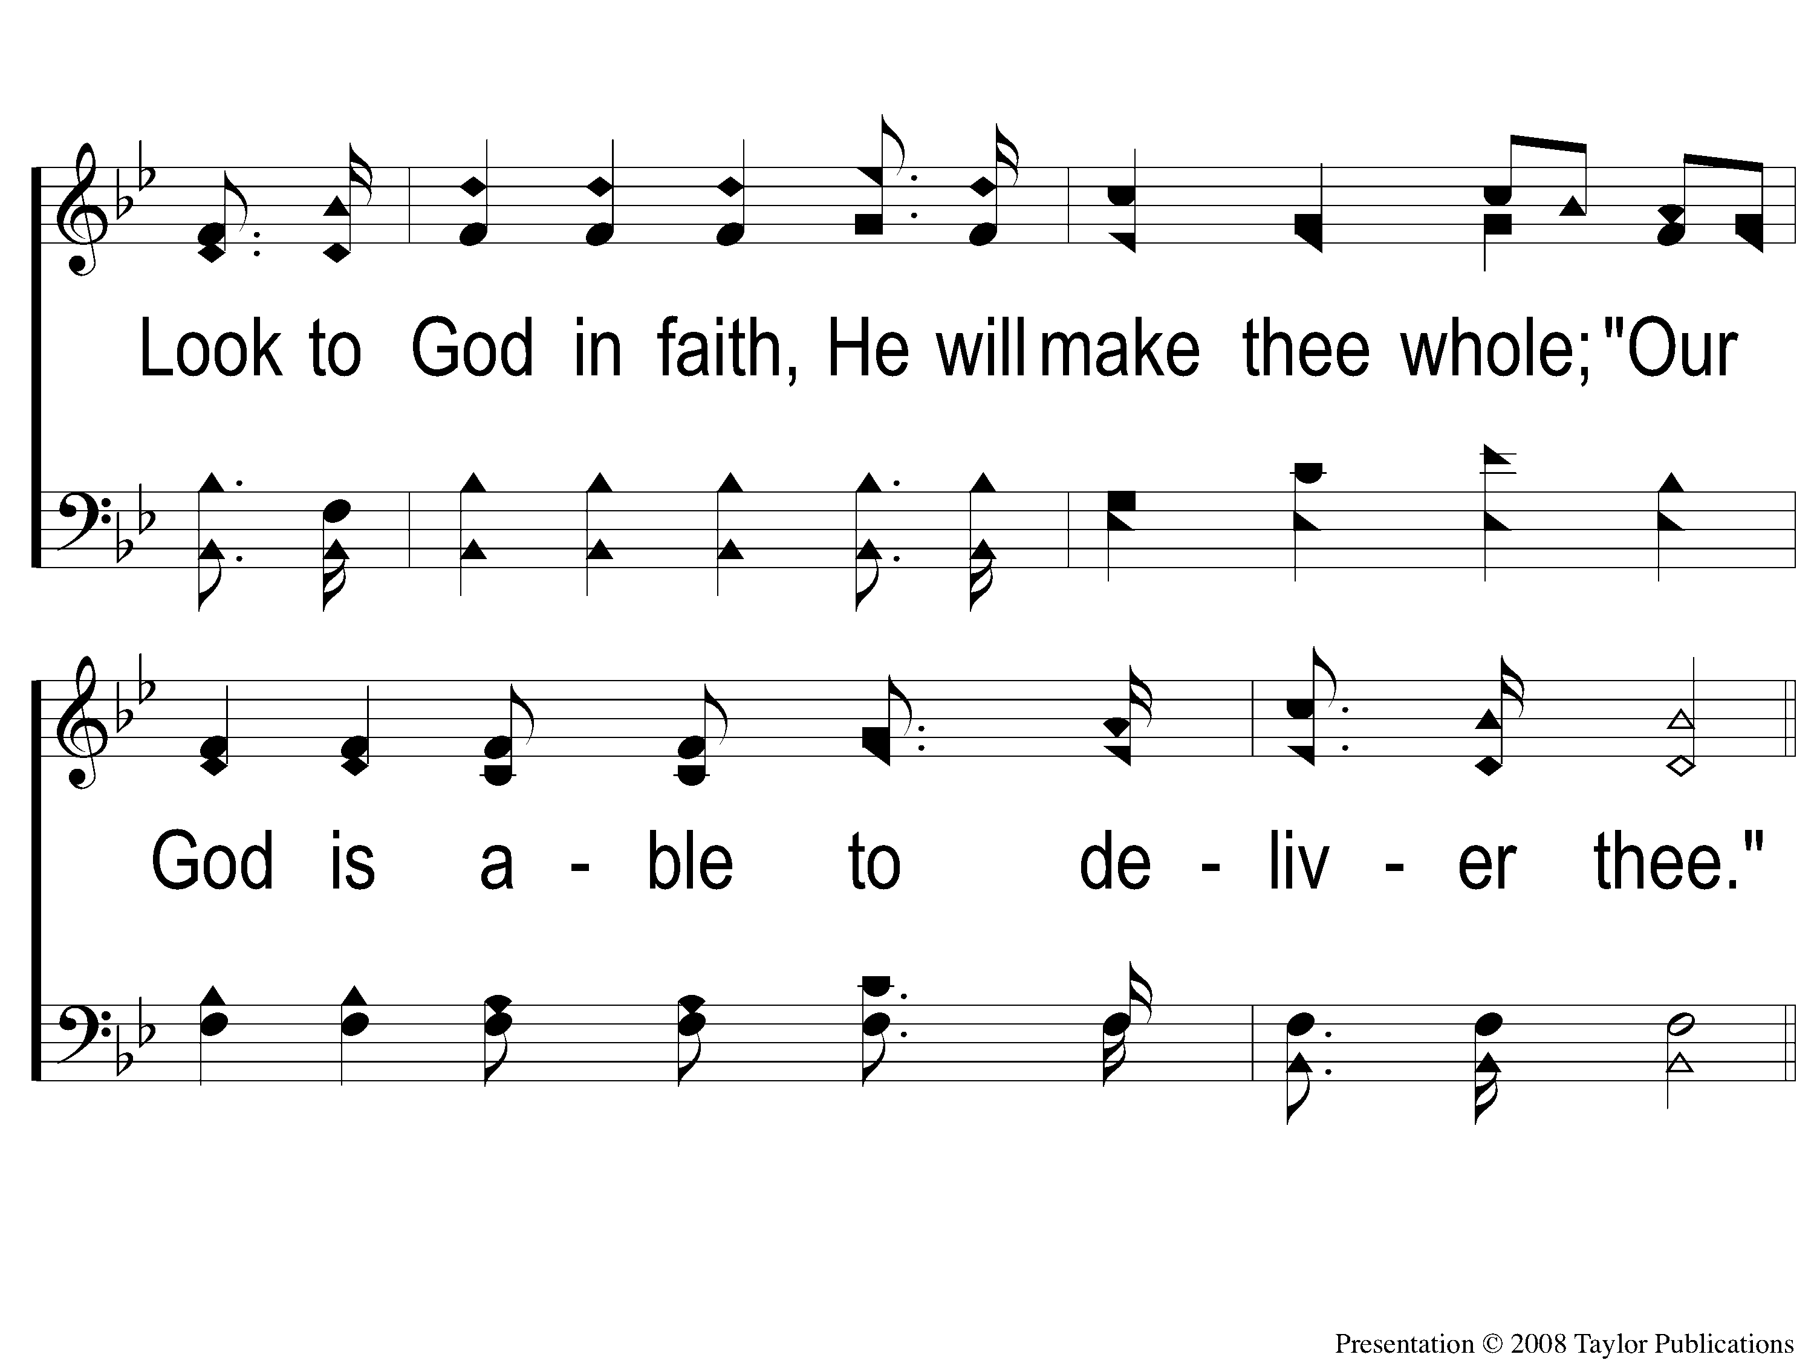
3-2 He Is Able To Deliver Thee
He Is Able To Deliver Thee
171

Slide 11
C-1 He Is Able To Deliver Thee
He Is Able To Deliver Thee
171

Slide 12
C-2 He Is Able To Deliver Thee
He Is Able To Deliver Thee
171

